Slide 1


Real-time Data Infrastructure at Uber Yupeng fu, Chinmay Soman Uber, Inc
PRESENTED BY bHARGHAV sHIVAM

Slide 2
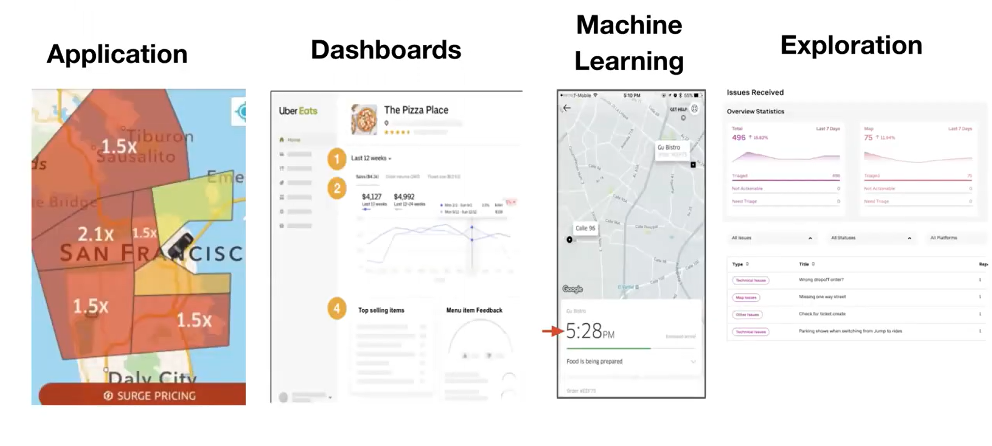
Data Generation @ Uber
PBs of data is collected from the end users such as Uber drivers, riders, restaurants, eaters etc.
For customer incentives, fraud detection, machine learning model prediction, data is useful to make decisions.
Also, this data is useful for engineers, data scientists, executives & operations.

Slide 3
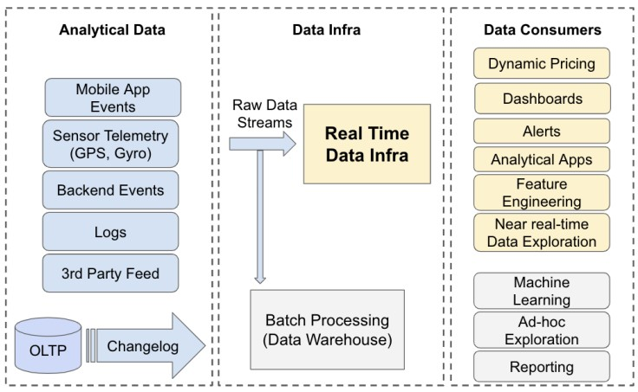
High-level data flow at uber infrastructure

Slide 4
Real time data processing needs & Scaling challenges
3 Main Areas to focus
Messaging Platform
Stream Processing
OnLine Analytical Processing (OLAP)
Each area must deal with 3 fundamental Scaling Challenges
Scaling data
Scaling use cases
Scaling users

Slide 5
Use cases – Requirements pertaining to real time data infrastructure
Consistency : Data to be consistent across all regions
Availability : Infrastructure stack must be highly available
Data Freshness : Events should be available quickly after their creation
Query Latency : Require the P99th query latency to be <= 1 second
Scalability : Ability to scale up with data without issues
Cost : Ensure the cost of data processing & serving to be low
Flexibility : Need programmatic & declarative interface

Slide 6
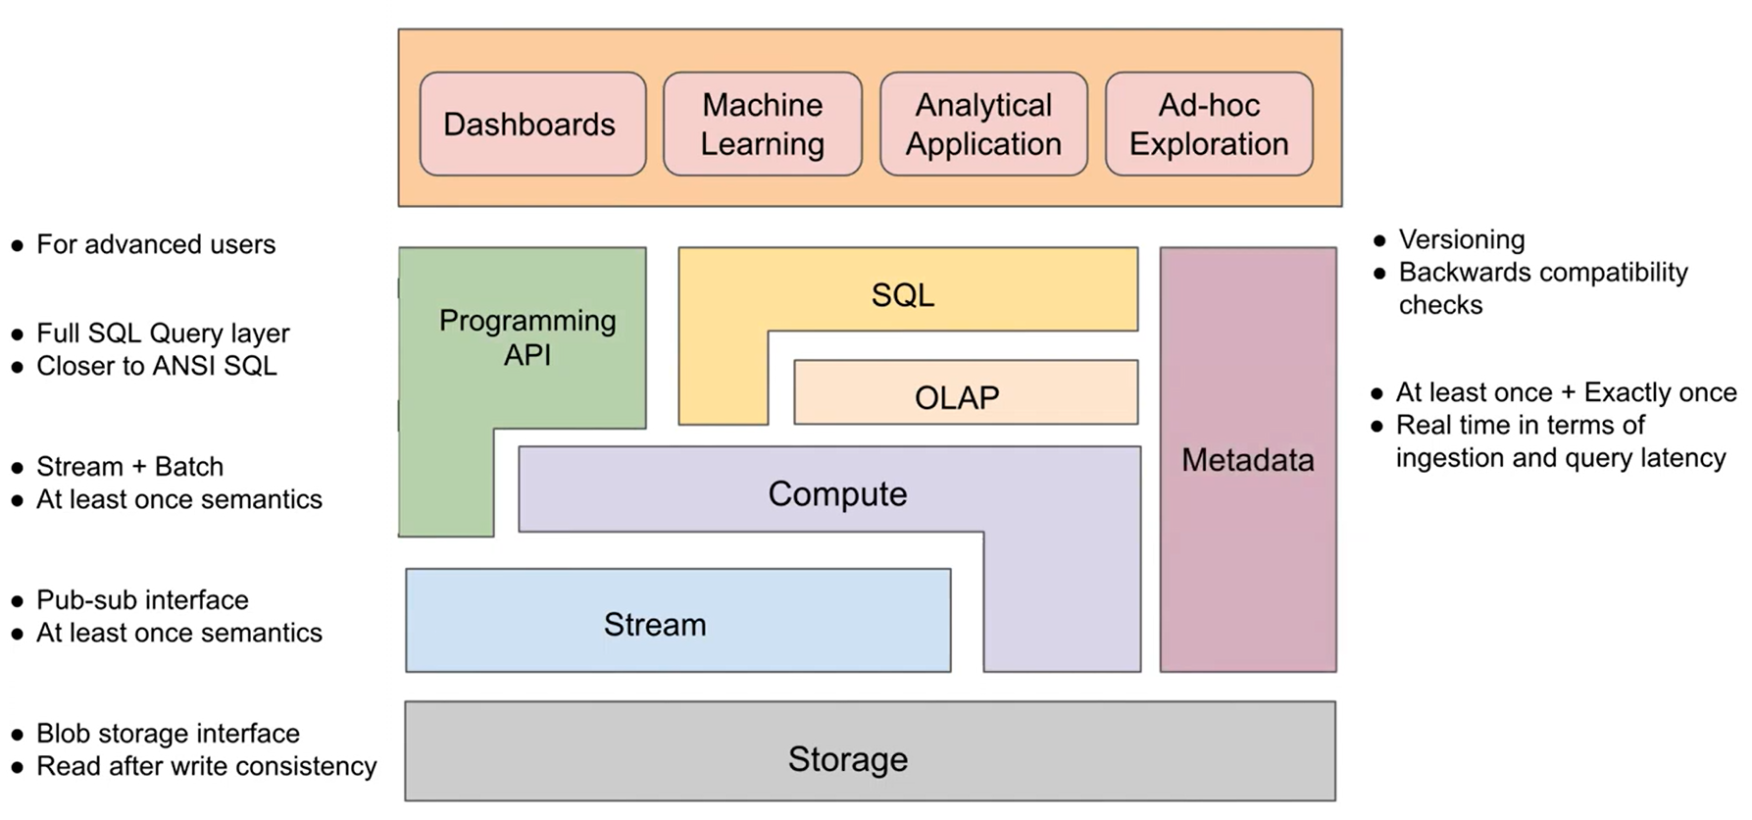
High level abstraction of real time data infrastructure – Overview of components

Slide 7
Apache Kafka for streaming storage
An open-source distributed event streaming system.
At Uber, Kafka is used for different workflows
Propagating event data from rider and driver apps
Enables a streaming analytics platform
Ingesting all sorts of data into Apache's Hadoop data lake
To meet Uber's requirements, they customized Kafka and added enhancements.

Slide 8
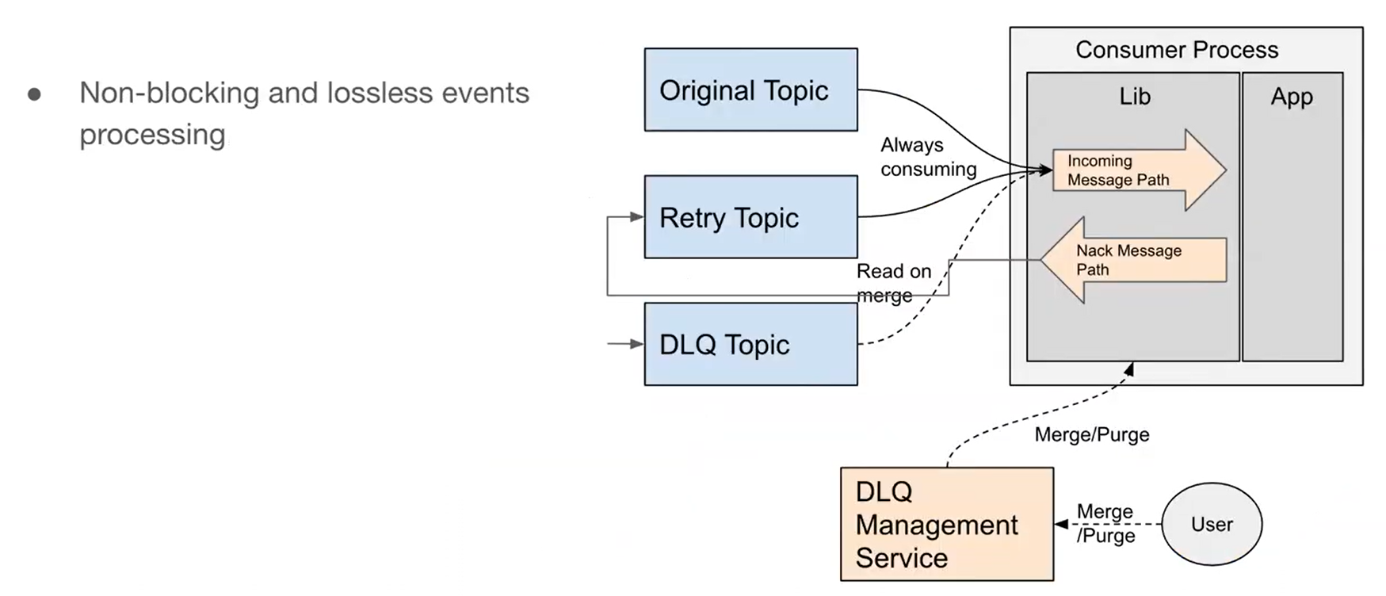
Apache Kafka Enhancements
Cluster Federation:
Used to improve reliability and scalability.
With federation, the Kafka service can scale horizontally by adding more clusters when a cluster is full
Dead Letter Queue:
During failure of message processing, Kafka either drop those messages or retry indefinitely. DLQ on top of Kafka works as below

Slide 9
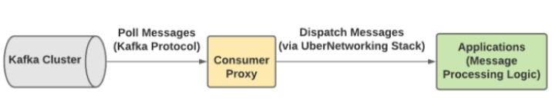
Apache Kafka Enhancements
Consumer Proxy:
To support users in troubleshooting and debugging.
It is useful to retry the failure message and to send them through DLQ.
Cross-cluster Replication:
uReplicator: In built rebalancing algorithm to minimize number of affected partitions during rebalancing.
Chaperone: No data loss during replication. Collects number of unique messages in a tumbling time window at every replication.

Slide 10
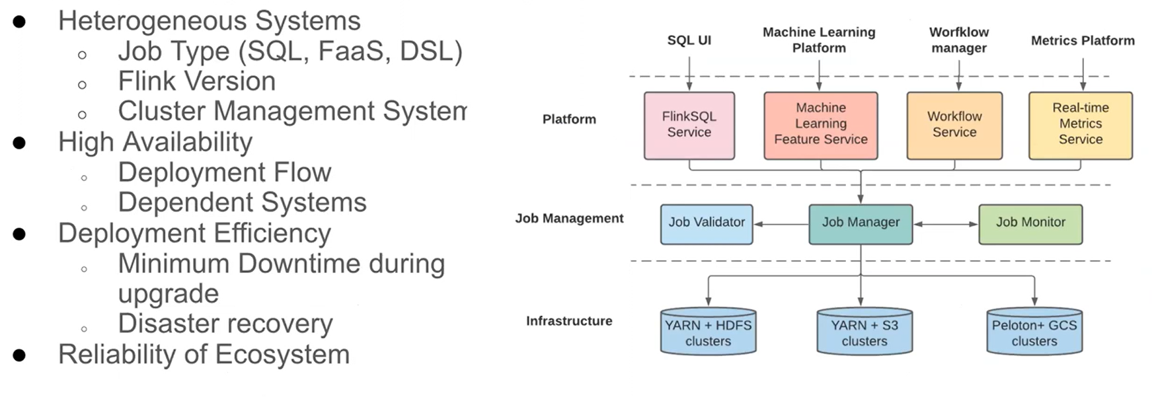
Apache Flink for stream processing -Enhancements
Building streaming analytical applications with SQL:
Flink SQL: converts the input SQL query into a logical plan, runs it through the query optimizer and creates a physical plan which can be translated into a Flink job using the corresponding Flink API
Unified architecture for deployment, management and operation:

Slide 11
Apache Pinot for OLAP -Enhancements
Upsert support: Scalable upsert solution on Pinot implemented to update the records during the real-time ingestion into the OLAP store.
Full SQL support: Pinot lacks SQL features like subqueries and joins, so uber integrated Pinot with Presto for enabling standard PrestoSQL queries on Pinot tables
Integration with the rest of Data ecosystem: Pinot integrates with FlinkSQL as a data sink, so customers can simply build a SQL transformation query and the output messages can be “pushed” to Pinot.
Peer to peer segment recovery: Segment store failures caused all data ingestion to come to a halt. An asynchronous solution is implemented where server replicas can serve the archived segments in case of failures

Slide 12
HDFS for archival store and Presto for Interactive query
HDFS: Used for long term storage of all data. Apache Flink uses HDFS for maintaining the job check points. Apache Pinot uses HDFS for long term segment archival.
Presto: To perform exploration on real-time data, Uber leveraged Presto’s connector model and built a Pinot connector to deeply integrate with Apache Pinot so that we can execute standard Presto SQL queries on fresh data.

Slide 13
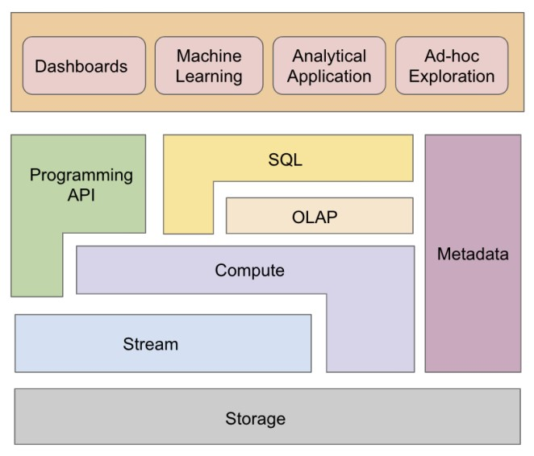
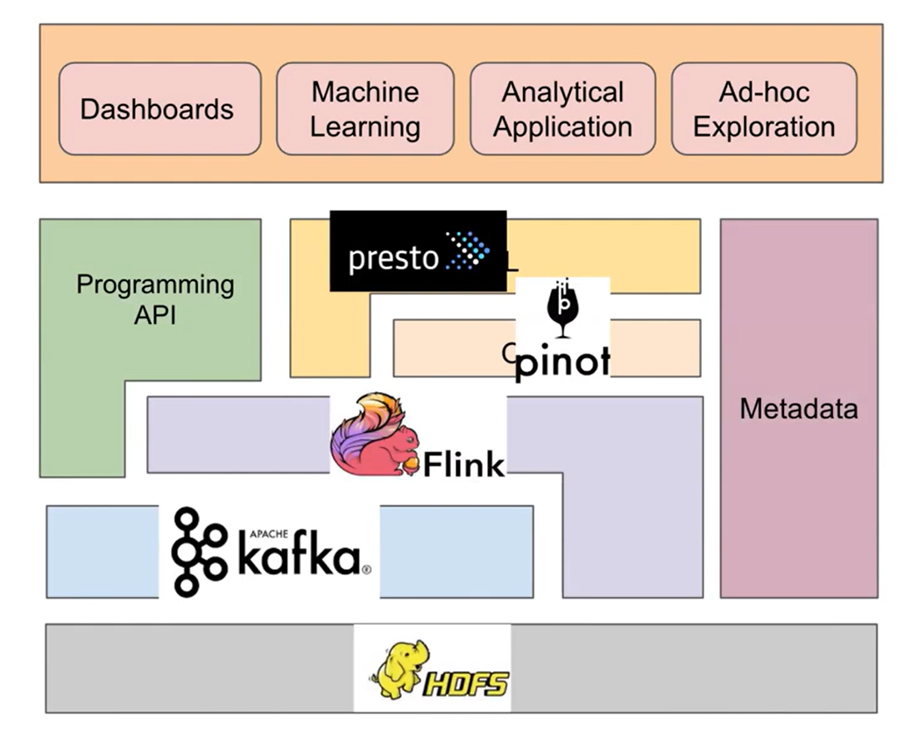

Slide 14


Use Cases Analysis
1. Analytical Application : Surge Pricing
What is surge pricing?
Key components – API, compute, stream
Key requirements – data freshness and availability
How it works
Ingest streaming data from Kafka
Run a machine learning based algorithm in Flink
Store the result in a key-value sink

Slide 15
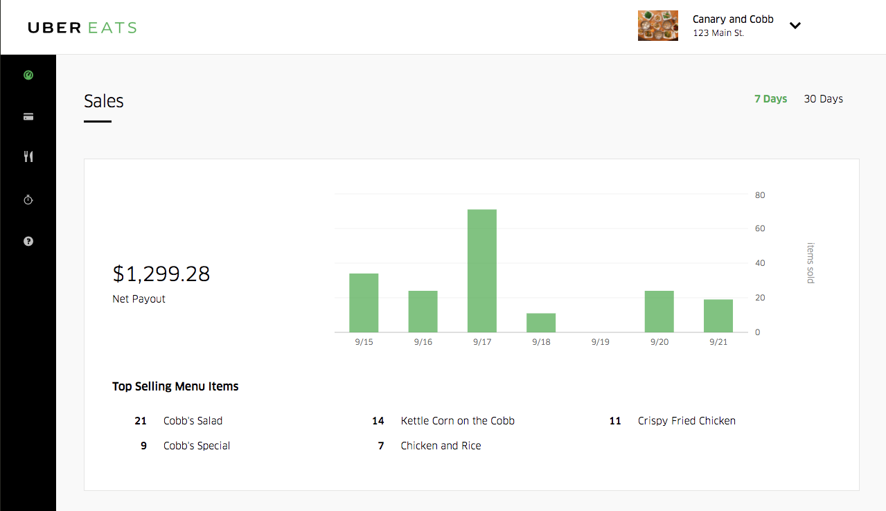
Use Cases Analysis
2. Dashboards: Ubereats restaurant manager
Key components – SQL, OLAP, compute, stream, storage
Key requirements – data freshness and low query latency

Slide 16
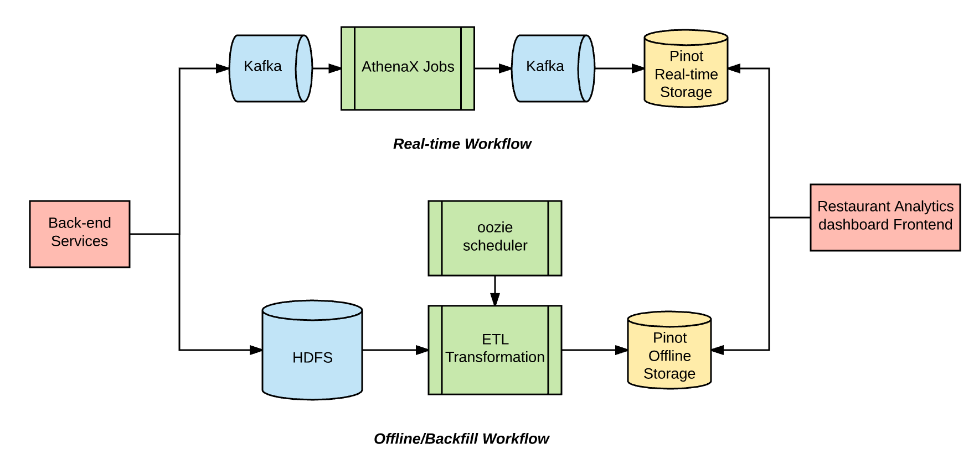
Use Cases Analysis
2. Dashboards: Ubereats restaurant manager (contd…)

Slide 17
Use Cases Analysis
3. Machine Learning: real-time prediction monitoring
Machine Learning has been critical at uber
Key components – API, SQL, OLAP, Compute, Stream, Storage
Key requirements – Scalability
A real-time prediction monitoring pipeline joins the predictions to the observed outcomes generated by the data pipeline
Ongoing, live measurements of model accuracy are created

Slide 18
Use Cases Analysis
4. Ad-hoc exploration: Ubereats ops automation
To execute "ad hoc analytical queries" on real time data generated by users of uber
Key components – SQL, OLAP, Compute, Stream
Key requirements – Reliability and Scalability
Uber ops team used it to combat covid 19 and keep restaurants open in different geographical locations
Pinot, Presto and Flink were scaled easily with the organic data growth and performed reliably during peak hours

Slide 19
All Active Strategy
Providing business resilience and continuity is a top priority for Uber
Disaster recovery plans to minimize the business impact from natural and man-made disasters
Ex- power outages, catastrophic software failures and network outages
Multi-region strategy
2 types of setups
Active-active
Active-passive

Slide 20
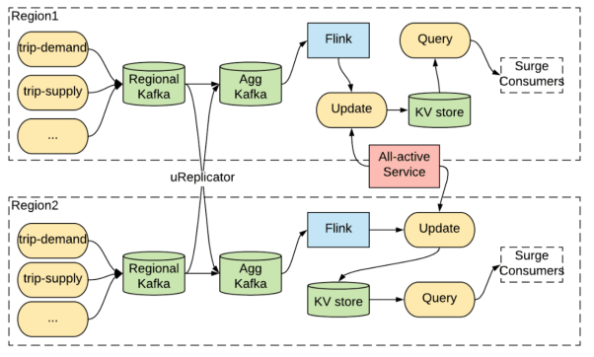
All Active Strategy
1. Active-Active Strategy

Slide 21
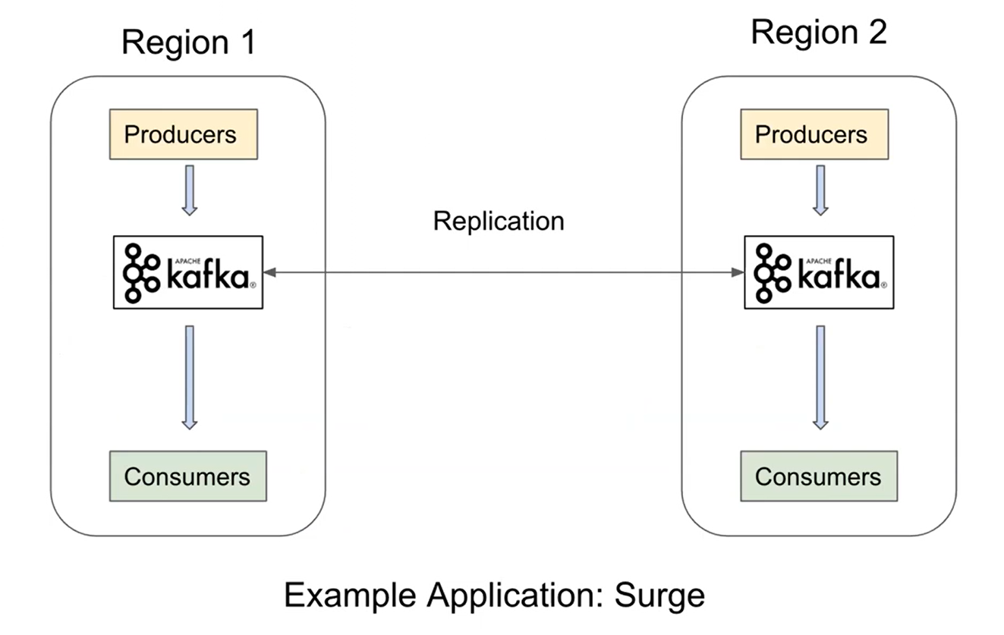
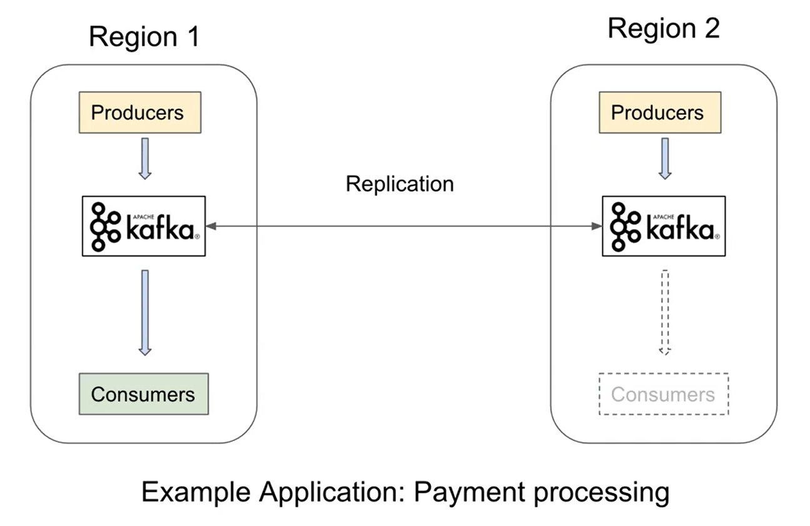
All Active Strategy
2. Active-Passive Strategy
Active-Active
Active-Passive

Slide 22
Backfill
Wherever there is real-time big data processing, there is backfill
Reasons for reprocessing data:
New data process pipelines
New machine learning model
Bug discovered in a real-time application
Change in stream processing logic
Solutions proposed:
Lambda architecture
Kappa architecture

Slide 23
Backfill
Both Lambda and Kappa architectures have limitations
Uber uses two solutions based on Flink
SQL-based
Same SQL query executed on both real-time and offline data
API-based
Reuse stream processing logic just like kappa architecture
Also has the ability to read archived data from offline datasets like hive
Same code can be executed on both streaming or batch data sources

Slide 24
Lessons Learnt
Open Source adoption
Pros: Reduce time to market
Cons: Lots of executions
Rapid system development and evolution
Enforce standardization (ex- kafka)
Monorepo, ci/cd
Ease of operation and monitoring
Automation around cluster setup, dashboards, alerts
Ease of user onboarding and debugging
Data discovery, Data audit, Self service onboarding

Slide 25
Future Work
Streaming and Batch processing unification
Multi-region and multi-zone deployments
On-prem and cloud agnostic
Tiered storage

